Slide 1
IMDB Prediction Analysis MIS665
By Graham Wood

Slide 2
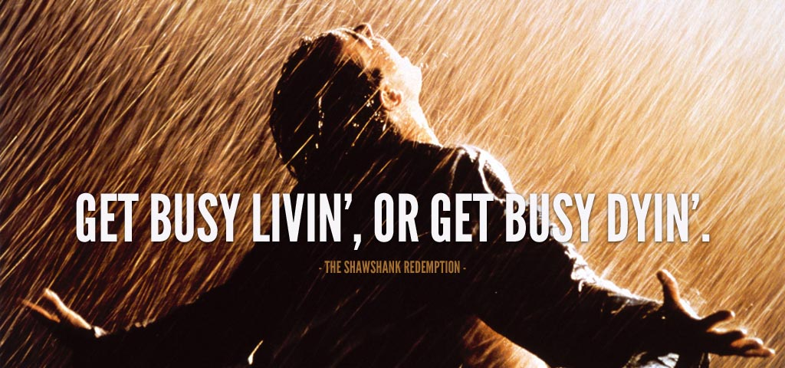
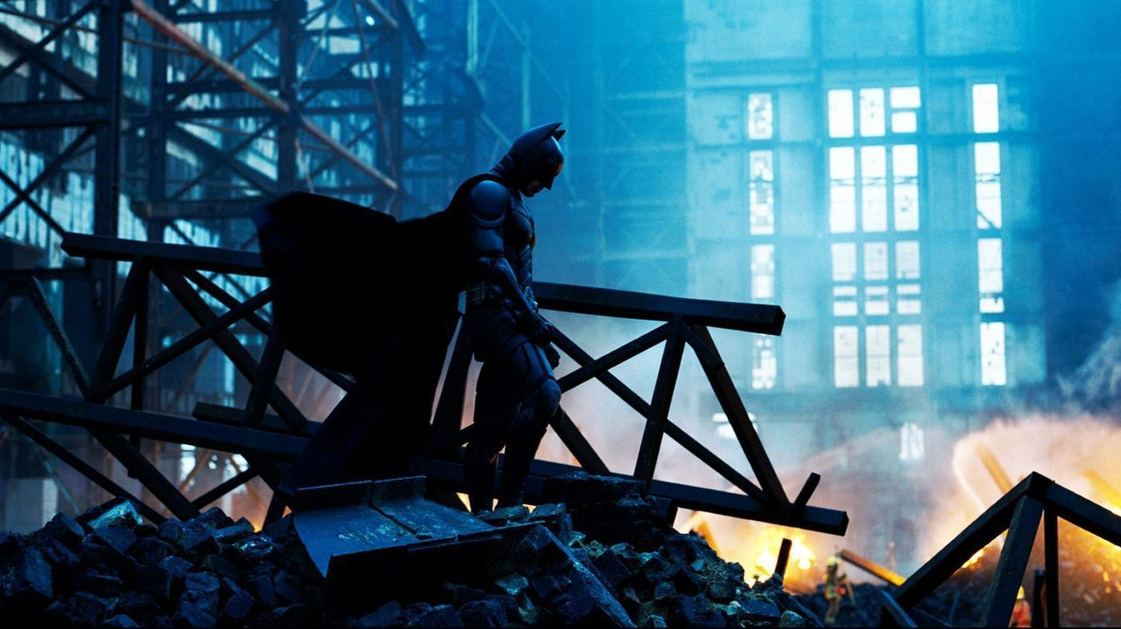
Goal
What makes a movie Great?

Slide 3
How
Machine Learning (SKLearn, randomForest, Regression Analysis, Classification Analysis)

Slide 4
Process
Data Acquisition
Data processing and analysis
Data cleaning
Data Preparation
Creating Insights
Creating Algorithms
Analyzing Results

Slide 5
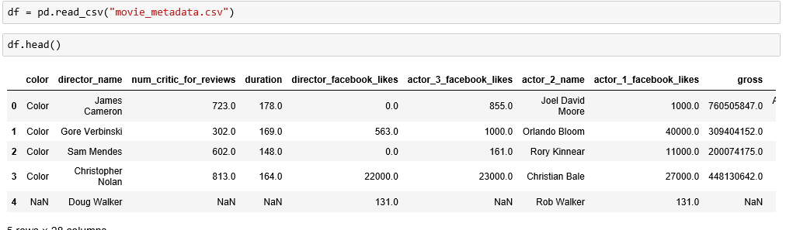
Data Acquisition
Data acquired from data world or Webscraping and loaded in

Slide 6
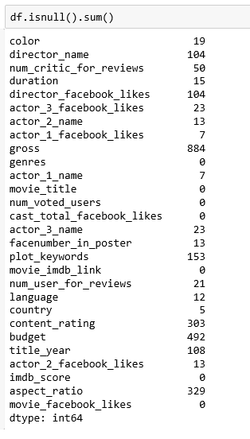
Look at the data and determine what needs done

Slide 7
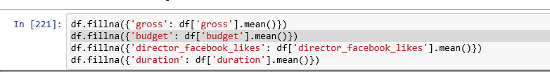
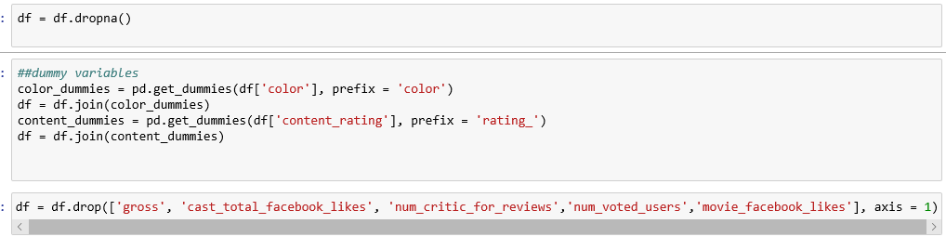
Clean and Prepare Data

Slide 8
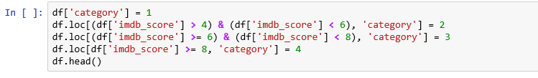
Clean and Prepare

Slide 9
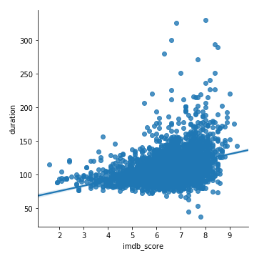
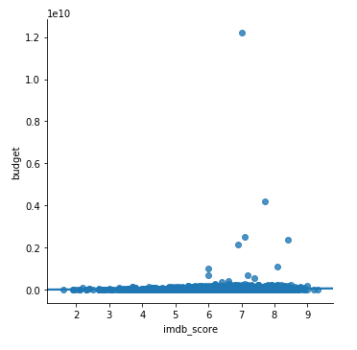
Create Insights

Slide 10
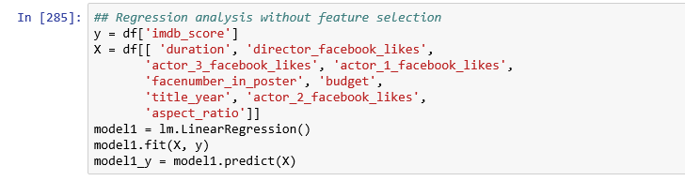
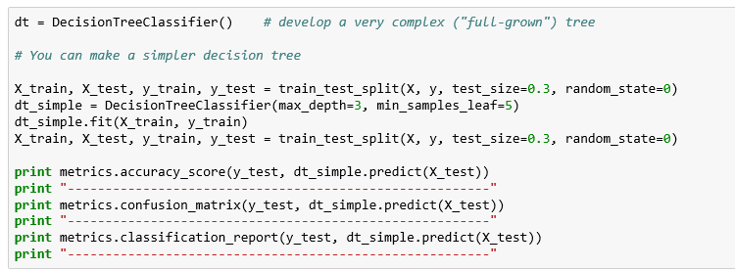
Creating Algorithms

Slide 11
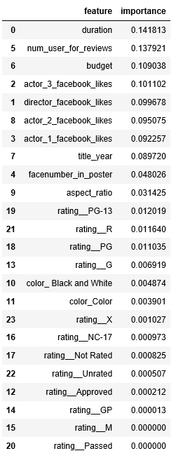

Results

